Slide 1




ON-THE-JOB TRAINING PROGRAM
OJT Employer Presentation
“You Hire! You Train! We Reimburse”
Updated 2/26/20

Slide 2
WELCOME
On-The-Job Training Employer Presentation
Rural Workforce Summit
January 12, 2021
On-The-Job-Training Program
Alabama Department of Commerce
Workforce Development Division (WDD)
PRESENTERS
Terry Comer – Commerce / WDD
Eboné Curry - Commerce / WDD

Slide 3
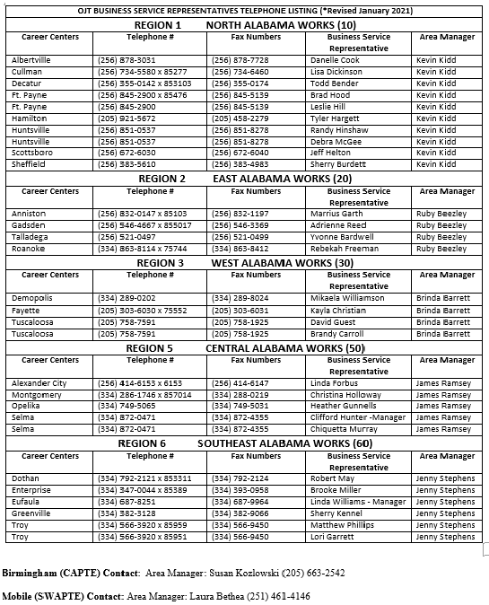
Contact Information
To obtain information about the On–The-Job Training Program, contact your local Alabama Career Center.

Slide 4


Contact Information
A listing of all Alabama Career Centers can be found at:
https://alabamaworks.alabama.gov/

Slide 5


OPENING REMARKS
OJT Training Programs Funding
OJT is funded by the U.S. Dept. of Labor. The Workforce Development Division (WDD) of The Alabama Department of Commerce administers the On-The-Job-Training programs.

Slide 6

What is On-The-Job Training? (OJT)
On-The-Job Training (OJT) is an Employer Specific Training Program.
Affords an individual an opportunity to learn new job skills.
Allows employers an opportunity to train NEW employees while saving money on training costs.
The Business Service Representative at the servicing Career Center initiates all of the paperwork, including the invoices for reimbursements

Slide 7


What is On-The-Job Training? (OJT)
The OJT Business Service Representative at the local Career Center, along with the employer will work together to create a training plan (job description) that defines the training objectives and goals for the trainee(s).

Slide 8


TWO TYPES OF OJT PROGRAMS
We offer two types of On-The-Job Training programs through The Workforce Innovation and Opportunity Act (WIOA) and the Alabama Career Center System.
Two Types of OJT Programs
(1.) New Hire On-The-Job Training
(2.) Performance-Based On-The-Job Training

Slide 9

(1.) New Hire On-The-Job Training Program
Offers an employer up to 75% wage reimbursement for training hours based on the chart below:
1-50 employees: Up to 75% reimbursement
51-200 employees: Up to 75% reimbursement for eligible Dislocated Workers (ONLY)
201 or more employees: Up to 50% reimbursement for all other businesses.
*All Public Sector/Non-Profit employers receive 50% reimbursement for eligible Adults, Youth, and Dislocated Workers
(Examples: City, State, County Governments, Hospitals, Police Officers, etc.)

Slide 10
(1.) New Hire On-The-Job Training Program
Employers are required to hire and train NEW employees
Training of 1 or more new employees that may need the duration of the training period.
Training can vary based on the work history and experience
Permanent employment upon successful completion of training
Training period can range from 6 to 26 weeks (6 months 1040 hours max)
Wage Cap of $19.66
Monthly invoices and reimbursements

Slide 11

(2.) Performance Based On-The-Job Training Program *NOTE: LETTER COMES FIRST
The Business Service Representative will first submit a letter of request to WDD
The letter of request includes the following information:
Employer’s Business Name
Information about the Employer(s)
Number of employees to be trained
Time period recommended for training (O*Net)
Wages per Hour
Training Hours
Training Plans/Job Descriptions
Details of the Employer(s) needs

Slide 12

(2.) Performance Based On-The-Job Training
Designed to offer training for a large number of employees over a short period of training time
Skilled and/or unskilled workers when time is of the essence (Need Trained Employees Fast)
Training period can range from 6-12 weeks depending on how technical the positions.
The average training hours range from
240 – 440 hours
Cost & Wages are negotiated through WDD on a case-by-case basis. Agreements are based on the employer’s needs at the time.
The Employer is eligible to receive all of the reimbursement for training after the employee completes the training plus one day.

Slide 13

Employer Benefits
How Will These Services Benefit You???
Employers can receive 50% or 75% reimbursement of trainees’ /employees’ hourly wages
Employers make all the hiring decisions
Employers tailor all training
Employers save $ on recruiting, screening, and training costs

Slide 14

Employer Benefits
Length of training is negotiable (6-26 weeks)
Minimal Paperwork for the employer
  Worker’s Compensation & E-Verify
Increased cash flow and profits
No cost for OJT Services – FREE!!!

Slide 15

Employer Requirements
Insurance requirement:
  Workmen’s Compensation or approved on-site accident insurance
    Note: Workmen’s Compensation is required in Alabama for employers with 5 or more employees
Enroll in the E-Verify program and provide documentation
Approval Requirement:
  Agreement must be approved before trainees/employees can begin work
Full-time employment is required
  The ONLY permissible Part-Time OJT training is for Vocational Rehabilitation Clients and Disabled Veterans. (*Requires a letter)

Slide 16

Employer Requirements (Cont.)
Trainees/Employees must meet WIOA Eligibility Requirements
Trainees/Employees must receive the same wages and benefits as other employees holding the same or similar positions
Trainees/Employees must abide by the same company policies as other employees
New Trainee(s)/Employee(s) cannot replace laid off workers

Slide 17

OTHER CAREER CENTER SERVICES
Youth Work-Based Learning Program
Incumbent Worker Program
State of Alabama EXPANSION OJT Program
Apprenticeship Alabama
Work Opportunity Tax Credit (WOTC)
Alabama Job Order Listings
Vocational Rehab Services
Resume Assistance
Veteran’s Services

Slide 18
OTHER CAREER CENTER SERVICES
Applicant Screening & Referrals
Pre-Employment Screening
Recruitment / Job Fairs / Workshops
Assistance with Closings & Layoffs
Office Equipment, Resource Room, and Conference Room Space for Employers
Labor Market Information

Slide 19
Commerce Workforce Development Division
CONTACT INFORMATION
Alabama Department of Commerce
Workforce Development Division
401 Adams Avenue
P.O. Box 304103
Montgomery, AL 36130-4103
(334) 242-5300
Terry Comer
(334) 242-5168
terry.comer@commerce.alabama.gov
Eboné Curry
(334) 242-5170
ebone.curry@commerce.alabama.gov

Slide 20
THANK YOU
For More information about the Alabama Department of Commerce, Alabama Career Center Information, and Alabama Workforce Resources, please visit the following websites:
madeinalabama.com alabamaworks.alabama.gov alabamaworks.com
The OJT Program is an equal opportunity employer program. Auxiliary aids and services are available upon request to individuals with disabilities.

